Slide 1
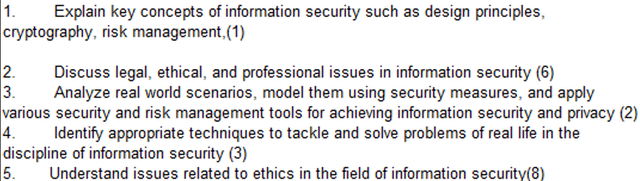
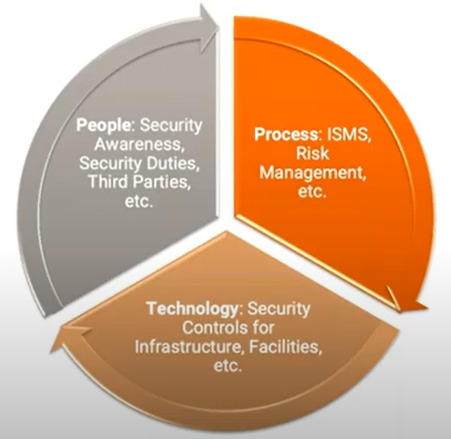
CS 3002 Information Security
Fall 2022
Week # 3 – Lecture # 6, 7, 8
9th , 10th , 12th Safar ul Muzaffar, 1445
6th , 7th, 9th September 2022
Dr. Nadeem Kafi Khan

Slide 2
Lecture # 6
Diffusion and Confusion
Feistel Network Construction
Advanced Encryption Standard (AES)

Slide 3
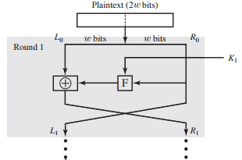
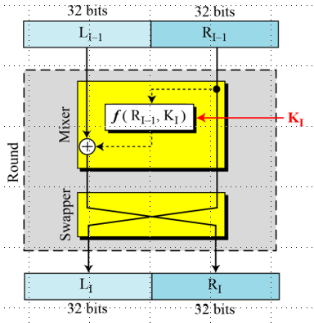
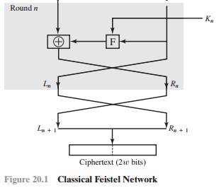

Textbook page 631-631

Slide 4
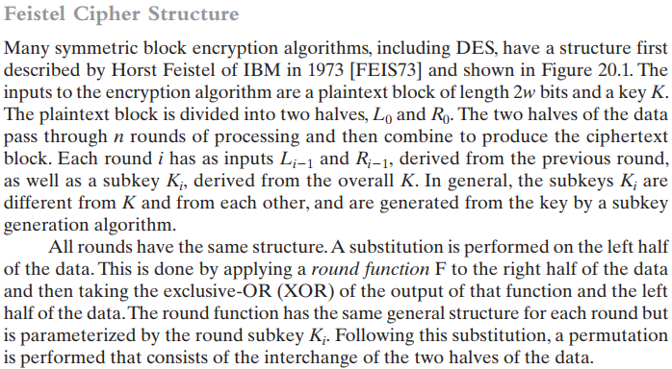
Textbook page 631-631

Slide 5
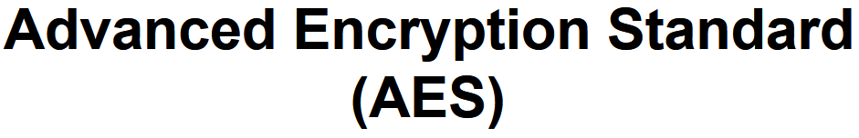

Slide 6
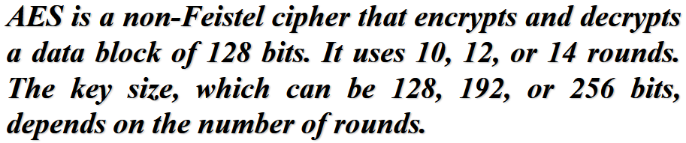
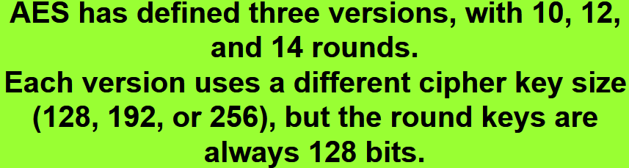

Slide 7
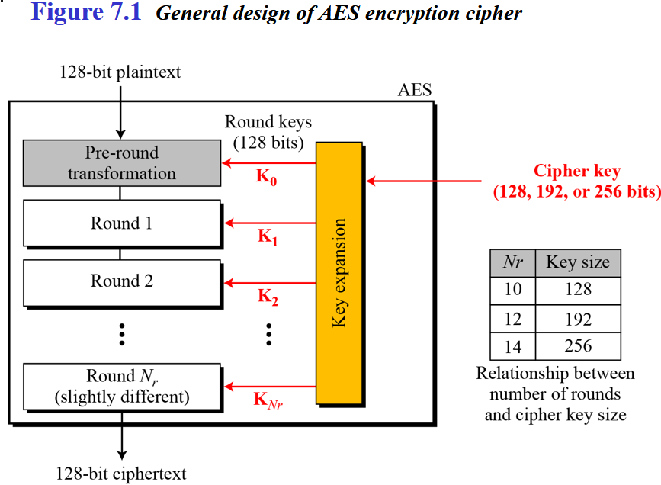

Slide 8
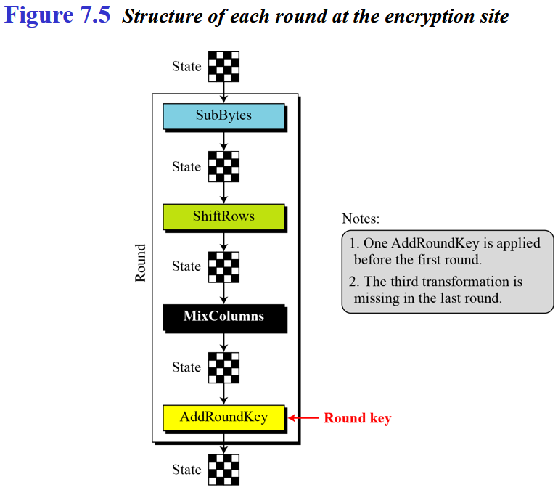

Slide 9
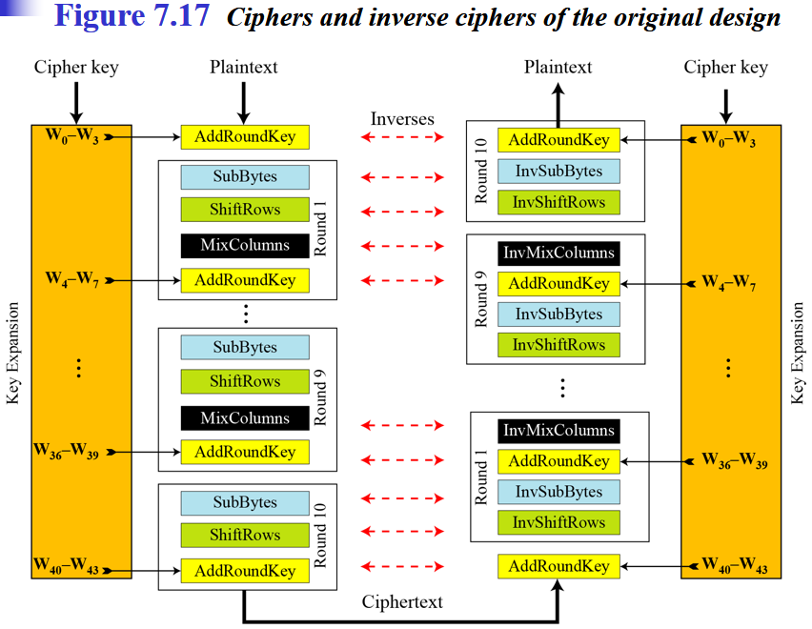

Slide 10
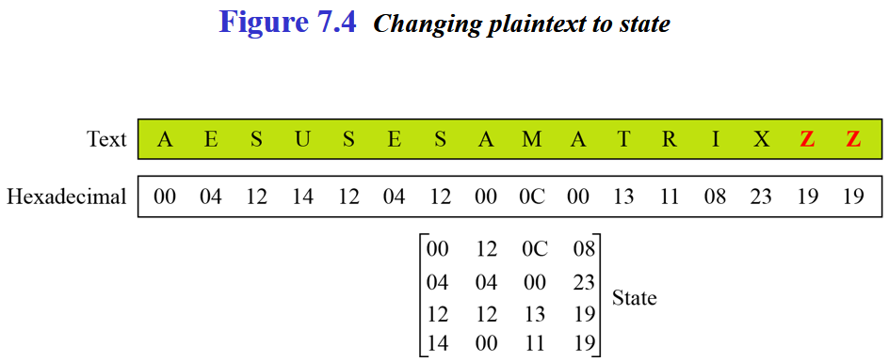
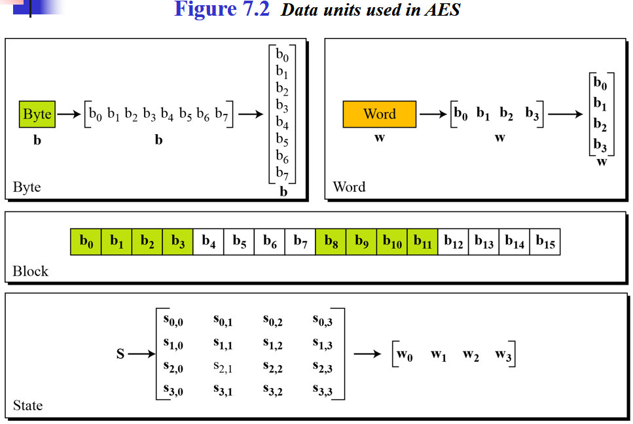
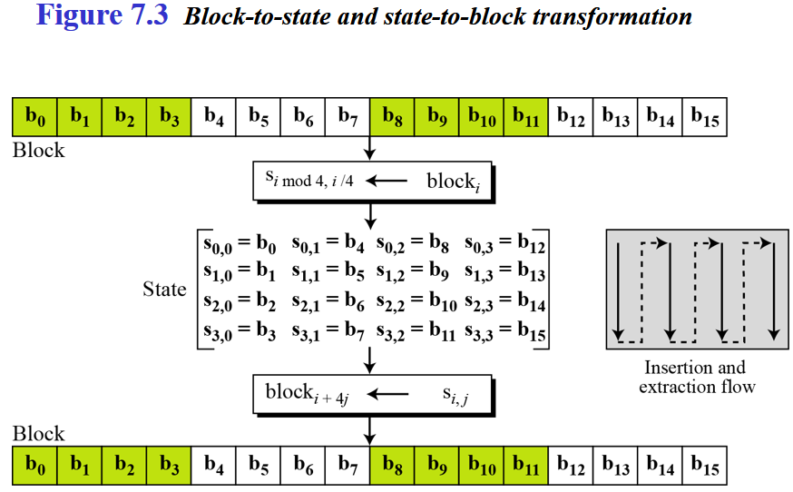

Slide 11
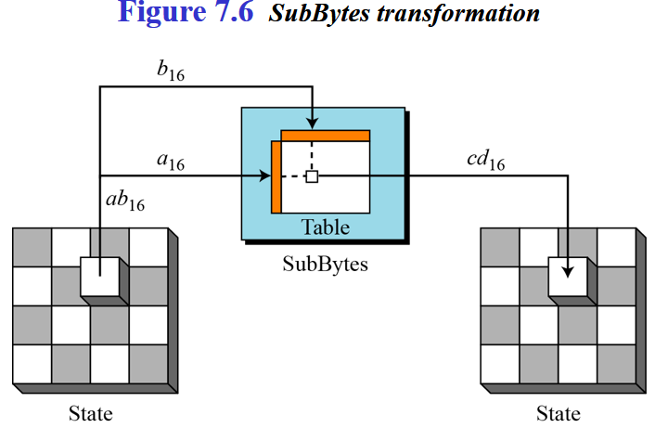
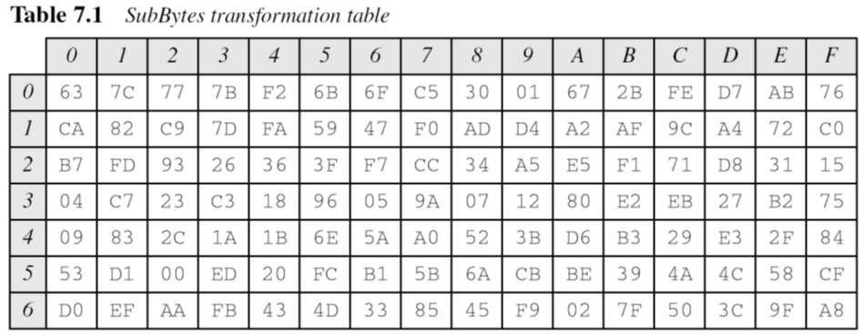
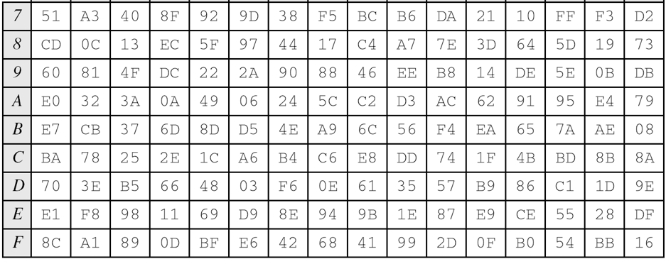
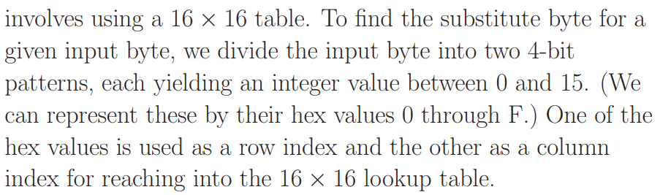

Slide 12

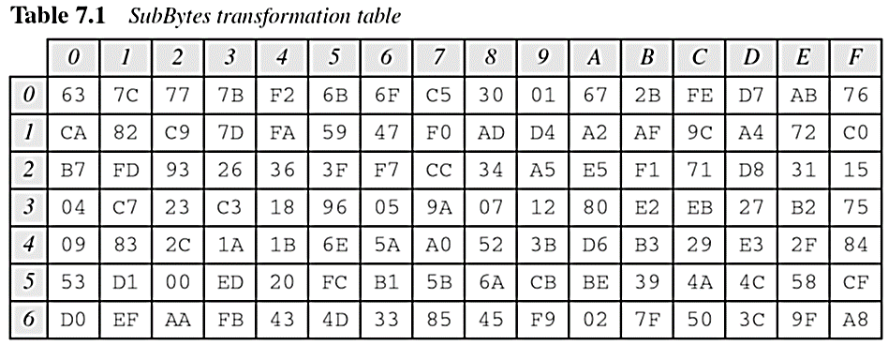
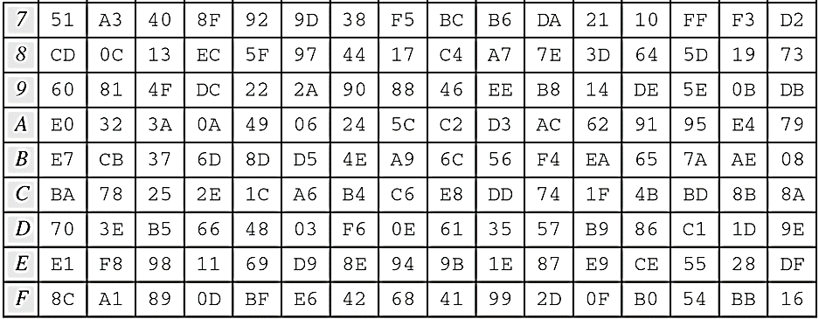
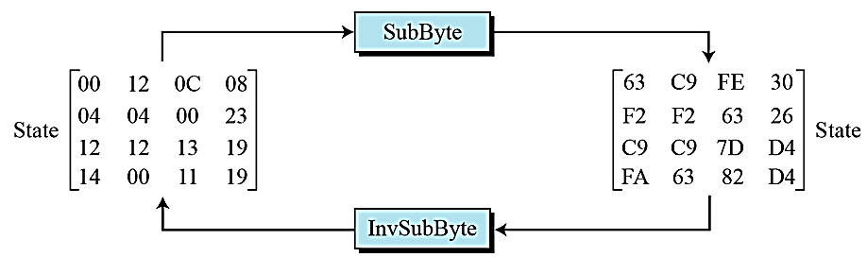

Slide 13
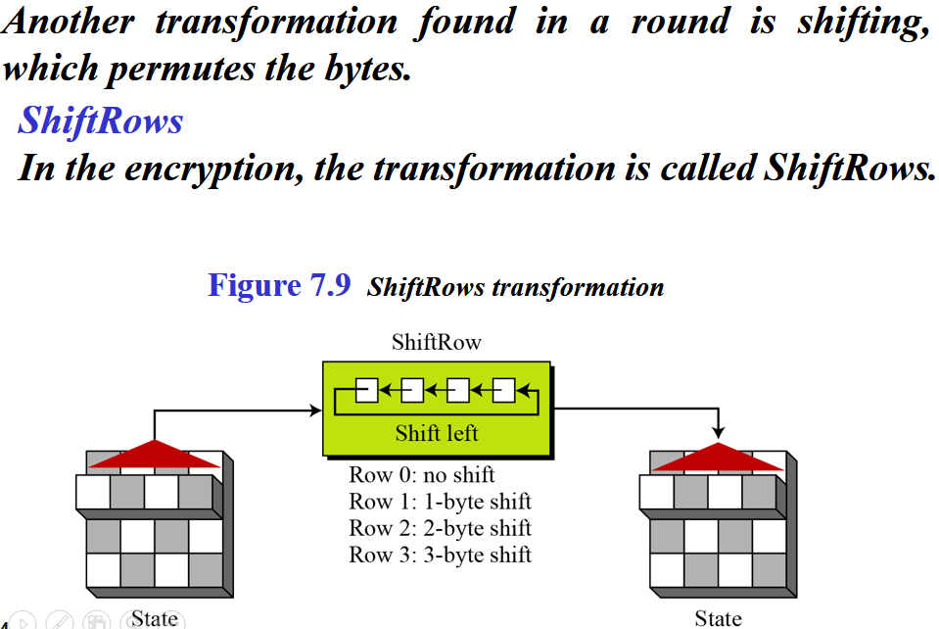
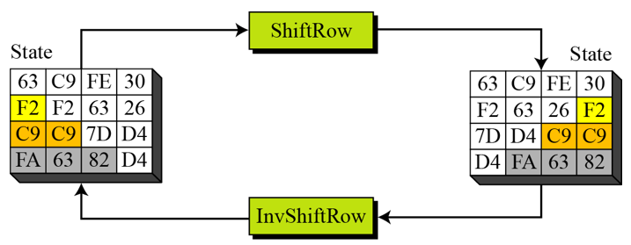

Slide 14
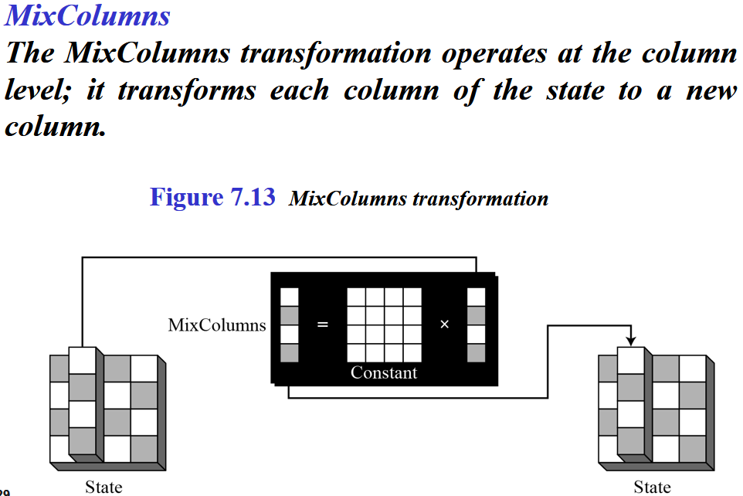

Slide 15

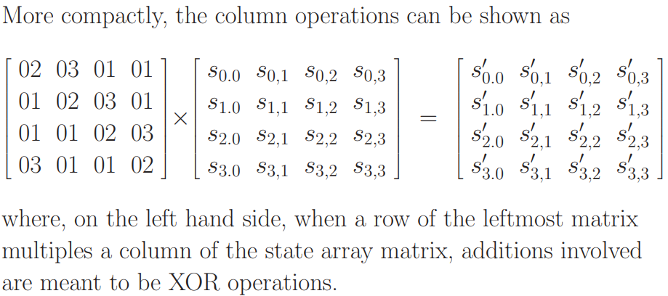
* The multiplications implied by the word ‘times’ and the additions implied by the word ‘plus’ are meant to be carried out in GF(2⁸) arithmetic

Slide 16
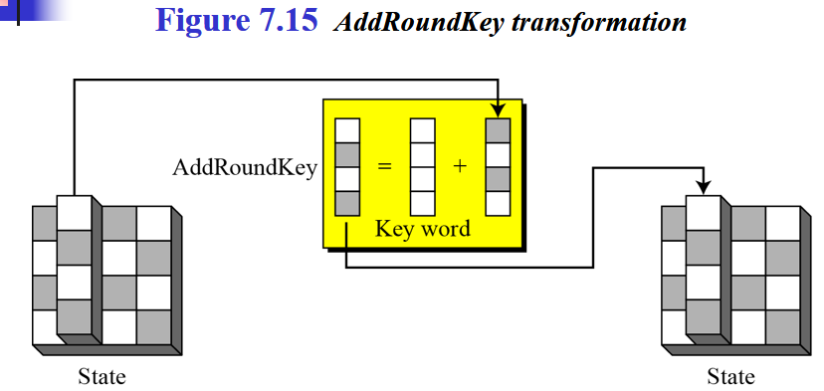
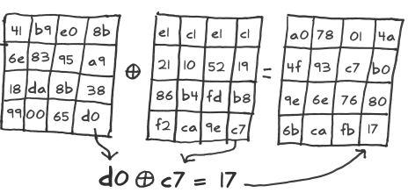
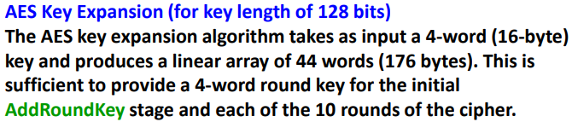

Slide 17
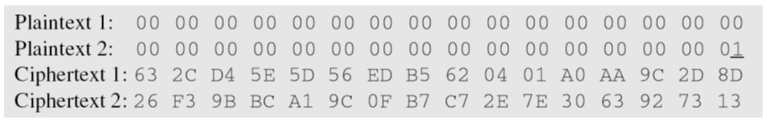
Claude Shannon (1949) gave two properties that a good cryptosystem should have to hinder statistical analysis: diffusion and confusion.
Diffusion means that if we change a character of the plaintext, then several characters of the ciphertext should change, and similarly, if we change a character of the ciphertext, then several characters of the plaintext should change.
Confusion means that the key does not relate in a simple way to the ciphertext. In particular, each character of the ciphertext should depend on several parts of the key.
Confusion = Substitution a --> b, Diffusion = Transposition or Permutation abcd --> dacb

Slide 18
Lecture # 7
Use of confidentiality, Integrity, Availability, Authentication and Auditability in real-world scenarios
Message Authentication
Message encryption is not a secure form of authentication
Message authentication without confidentiality
Message Authentication Code

Slide 19
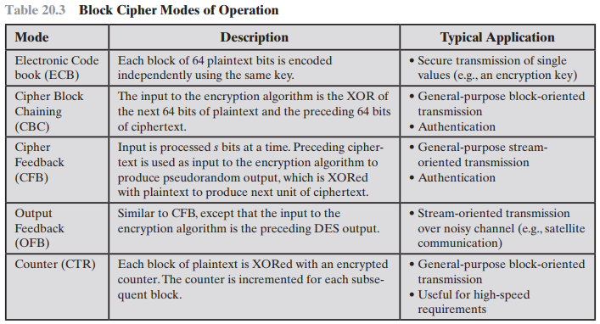
Read Only. We will touch on this topic during encryption lab.

Slide 20
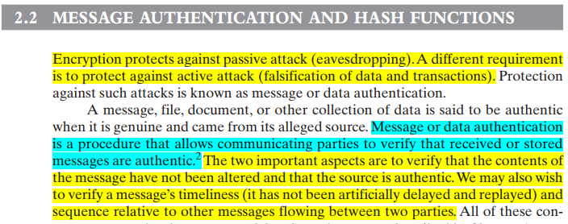

Slide 21
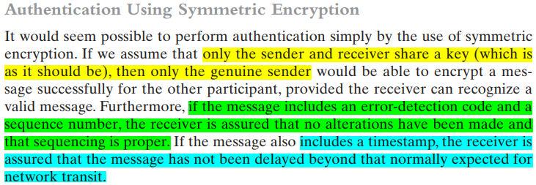

Slide 22
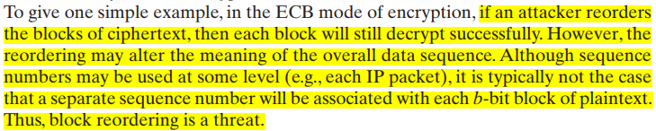
Message encryption by itself does not provide a secure form of authentication.
It is possible to combine authentication and confidentiality in a single algorithm by encrypting a message plus its authentication tag.
Message authentication is provided as a separate function from message encryption.

Slide 23
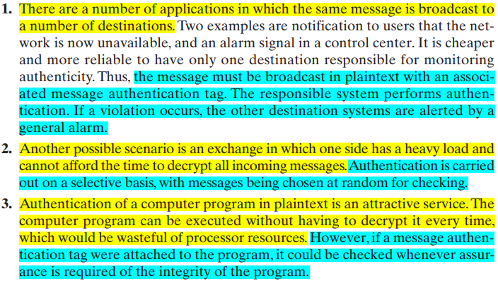
Three situations in which message authentication without confidentiality is preferable:

Slide 24
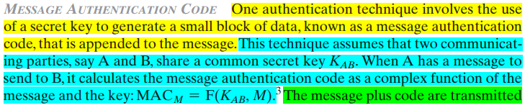


Slide 25
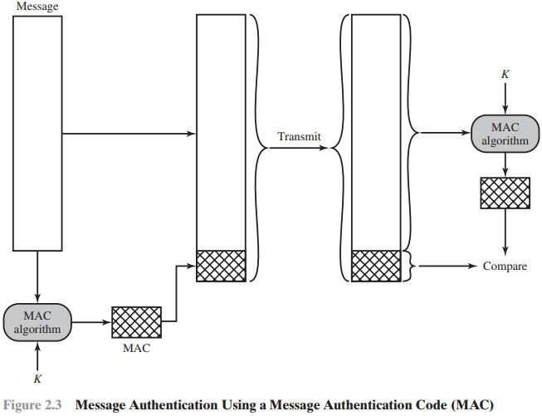
DES or AES is used to generate an encrypted version of the message, and some of the bits of ciphertext are used as the code. Longer codes are used to provide sufficient collision resistance. One difference is that the authentication algorithm need not be reversible, as it must for decryption.

Slide 26
Lecture # 8
One-Way Hash Functions
Reasons to avoid Encryption
Keyed Hash MAC
Hash Function Requirements

Slide 27
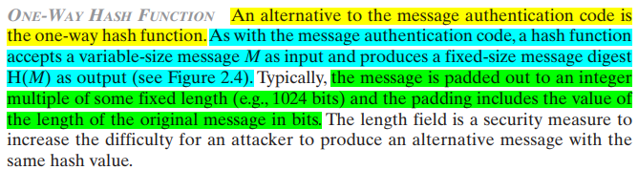


Slide 28
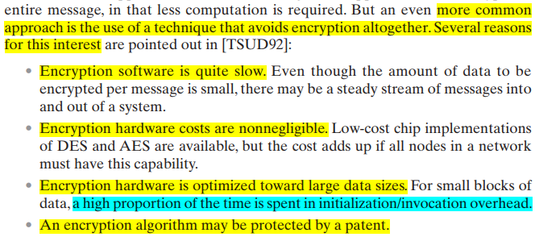

Slide 29
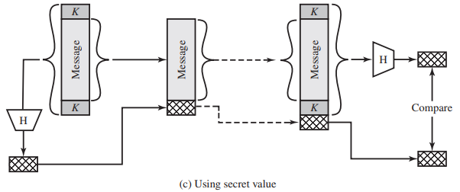
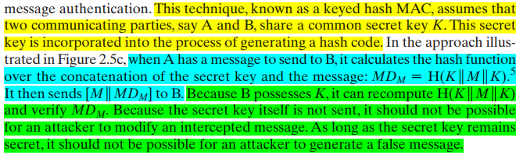

Slide 30

